Slide 1
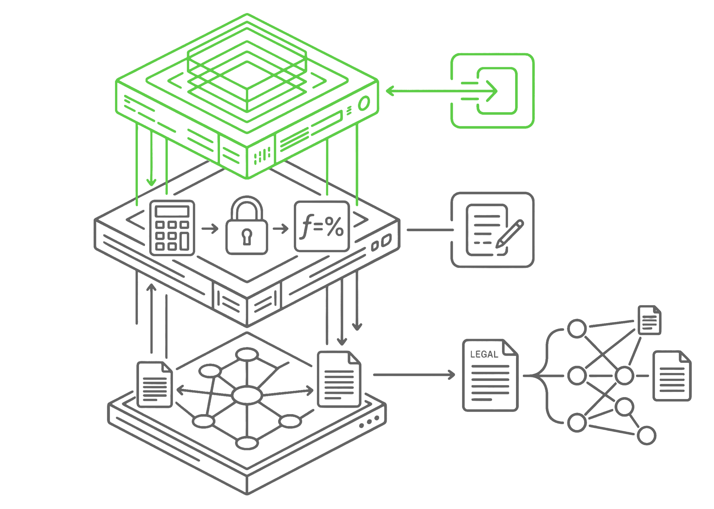
BUILT FOR THE WORK
Move faster without giving up control
Nodus applies the right kind of intelligence to the right part of the provision: AI to structure messy inputs, deterministic logic to run reproducible calculations, a graph to preserve relationships, and ASC 740 expertise to guide the judgment.
AI structures the inputs. Messy source materials become usable provision logic.
Deterministic logic runs the math. Excel executes the calculations, keeping the math transparent, reproducible, and review-ready.
The graph keeps the reasoning connected. Numbers, support, authority, assumptions, and judgment stay linked over time.
ASC 740 expertise guides the work. Human review stays in the process where professional judgment matters.
PROVISION CHAIN AUDIT

Slide 2
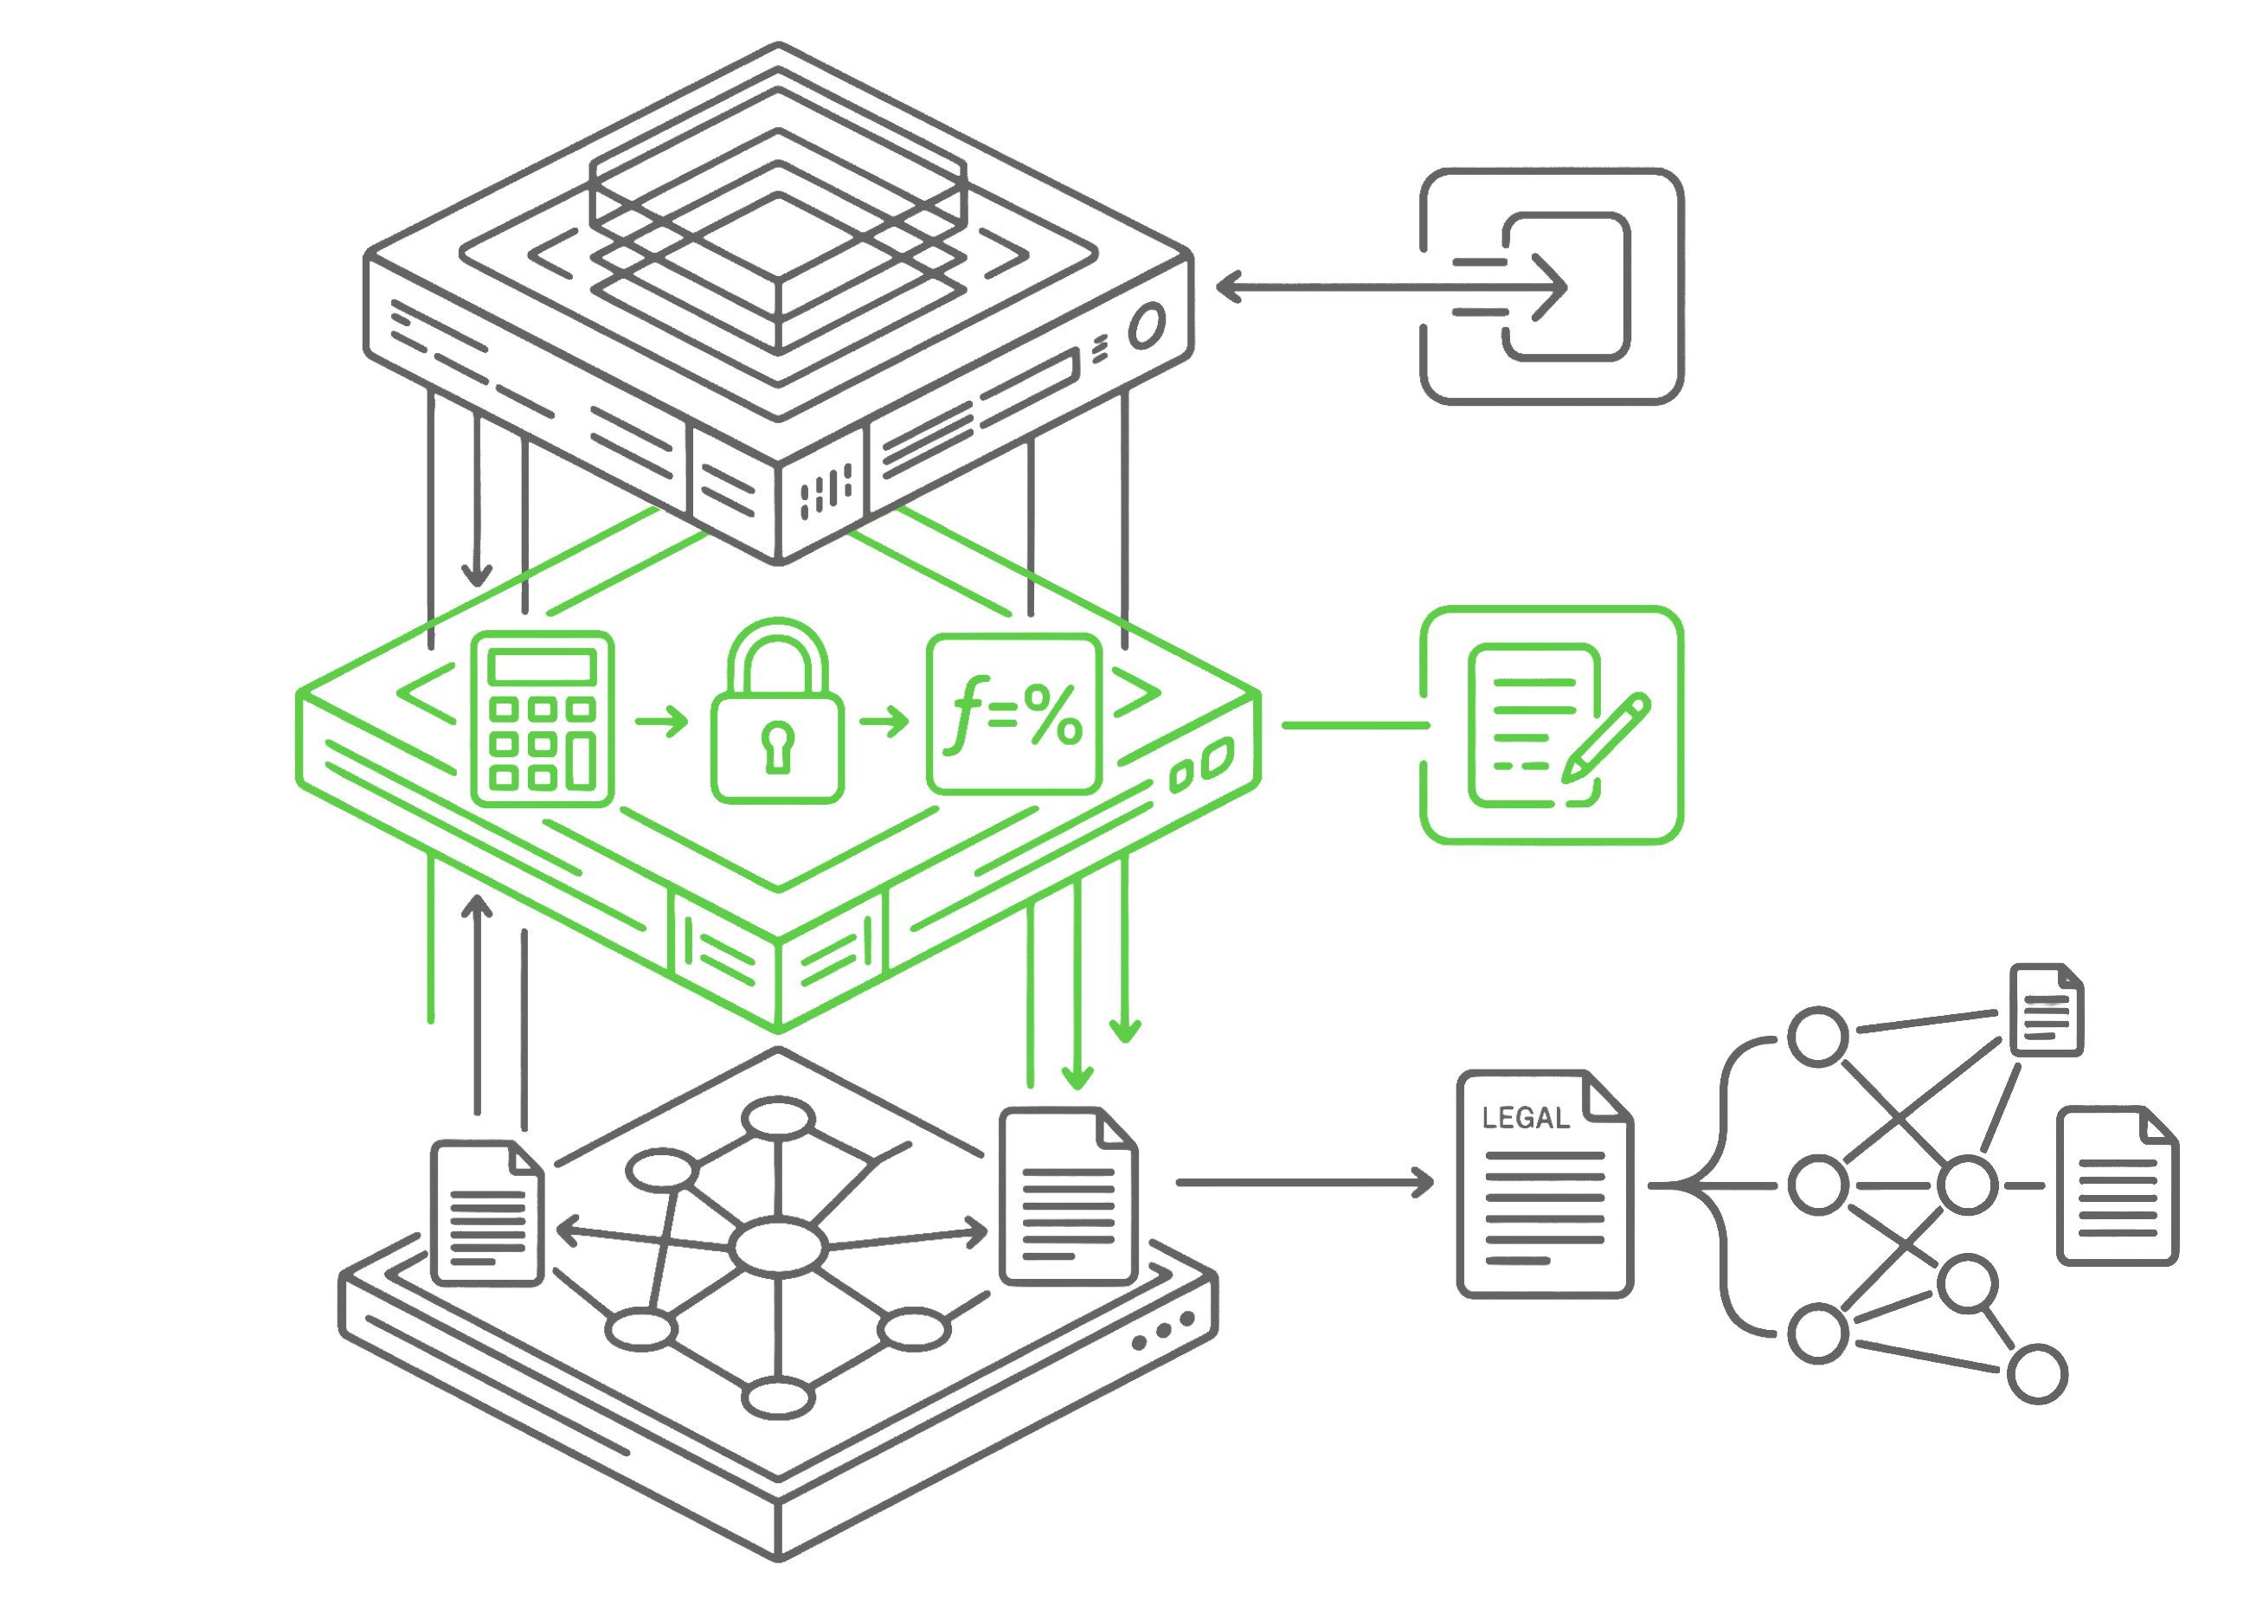
BUILT FOR THE WORK
Move faster without giving up control
Nodus applies the right kind of intelligence to the right part of the provision: AI to structure messy inputs, deterministic logic to run reproducible calculations, a graph to preserve relationships, and ASC 740 expertise to guide the judgment.
AI structures the inputs. Messy source materials become usable provision logic.
Deterministic logic runs the math. Excel executes the calculations, keeping the math transparent, reproducible, and review-ready.
The graph keeps the reasoning connected. Numbers, support, authority, assumptions, and judgment stay linked over time.
ASC 740 expertise guides the work. Human review stays in the process where professional judgment matters.
PROVISION CHAIN AUDIT

Slide 3
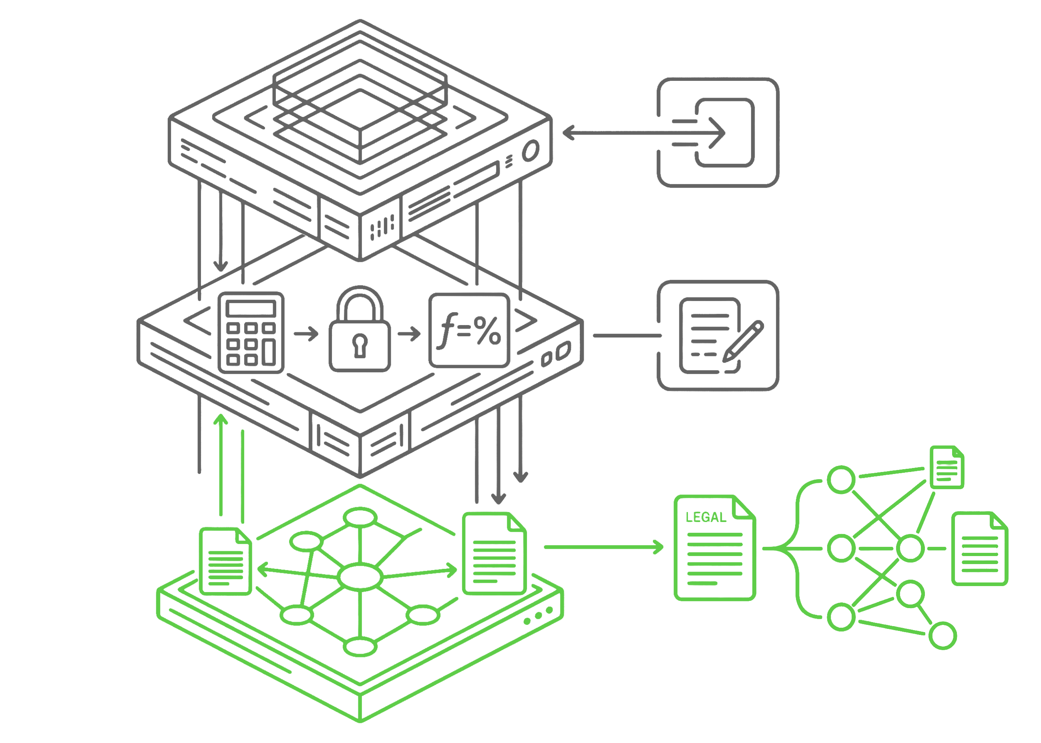
BUILT FOR THE WORK
Move faster without giving up control
Nodus applies the right kind of intelligence to the right part of the provision: AI to structure messy inputs, deterministic logic to run reproducible calculations, a graph to preserve relationships, and ASC 740 expertise to guide the judgment.
AI structures the inputs. Messy source materials become usable provision logic.
Deterministic logic runs the math. Excel executes the calculations, keeping the math transparent, reproducible, and review-ready.
The graph keeps the reasoning connected. Numbers, support, authority, assumptions, and judgment stay linked over time.
ASC 740 expertise guides the work. Human review stays in the process where professional judgment matters.
PROVISION CHAIN AUDIT

Slide 4
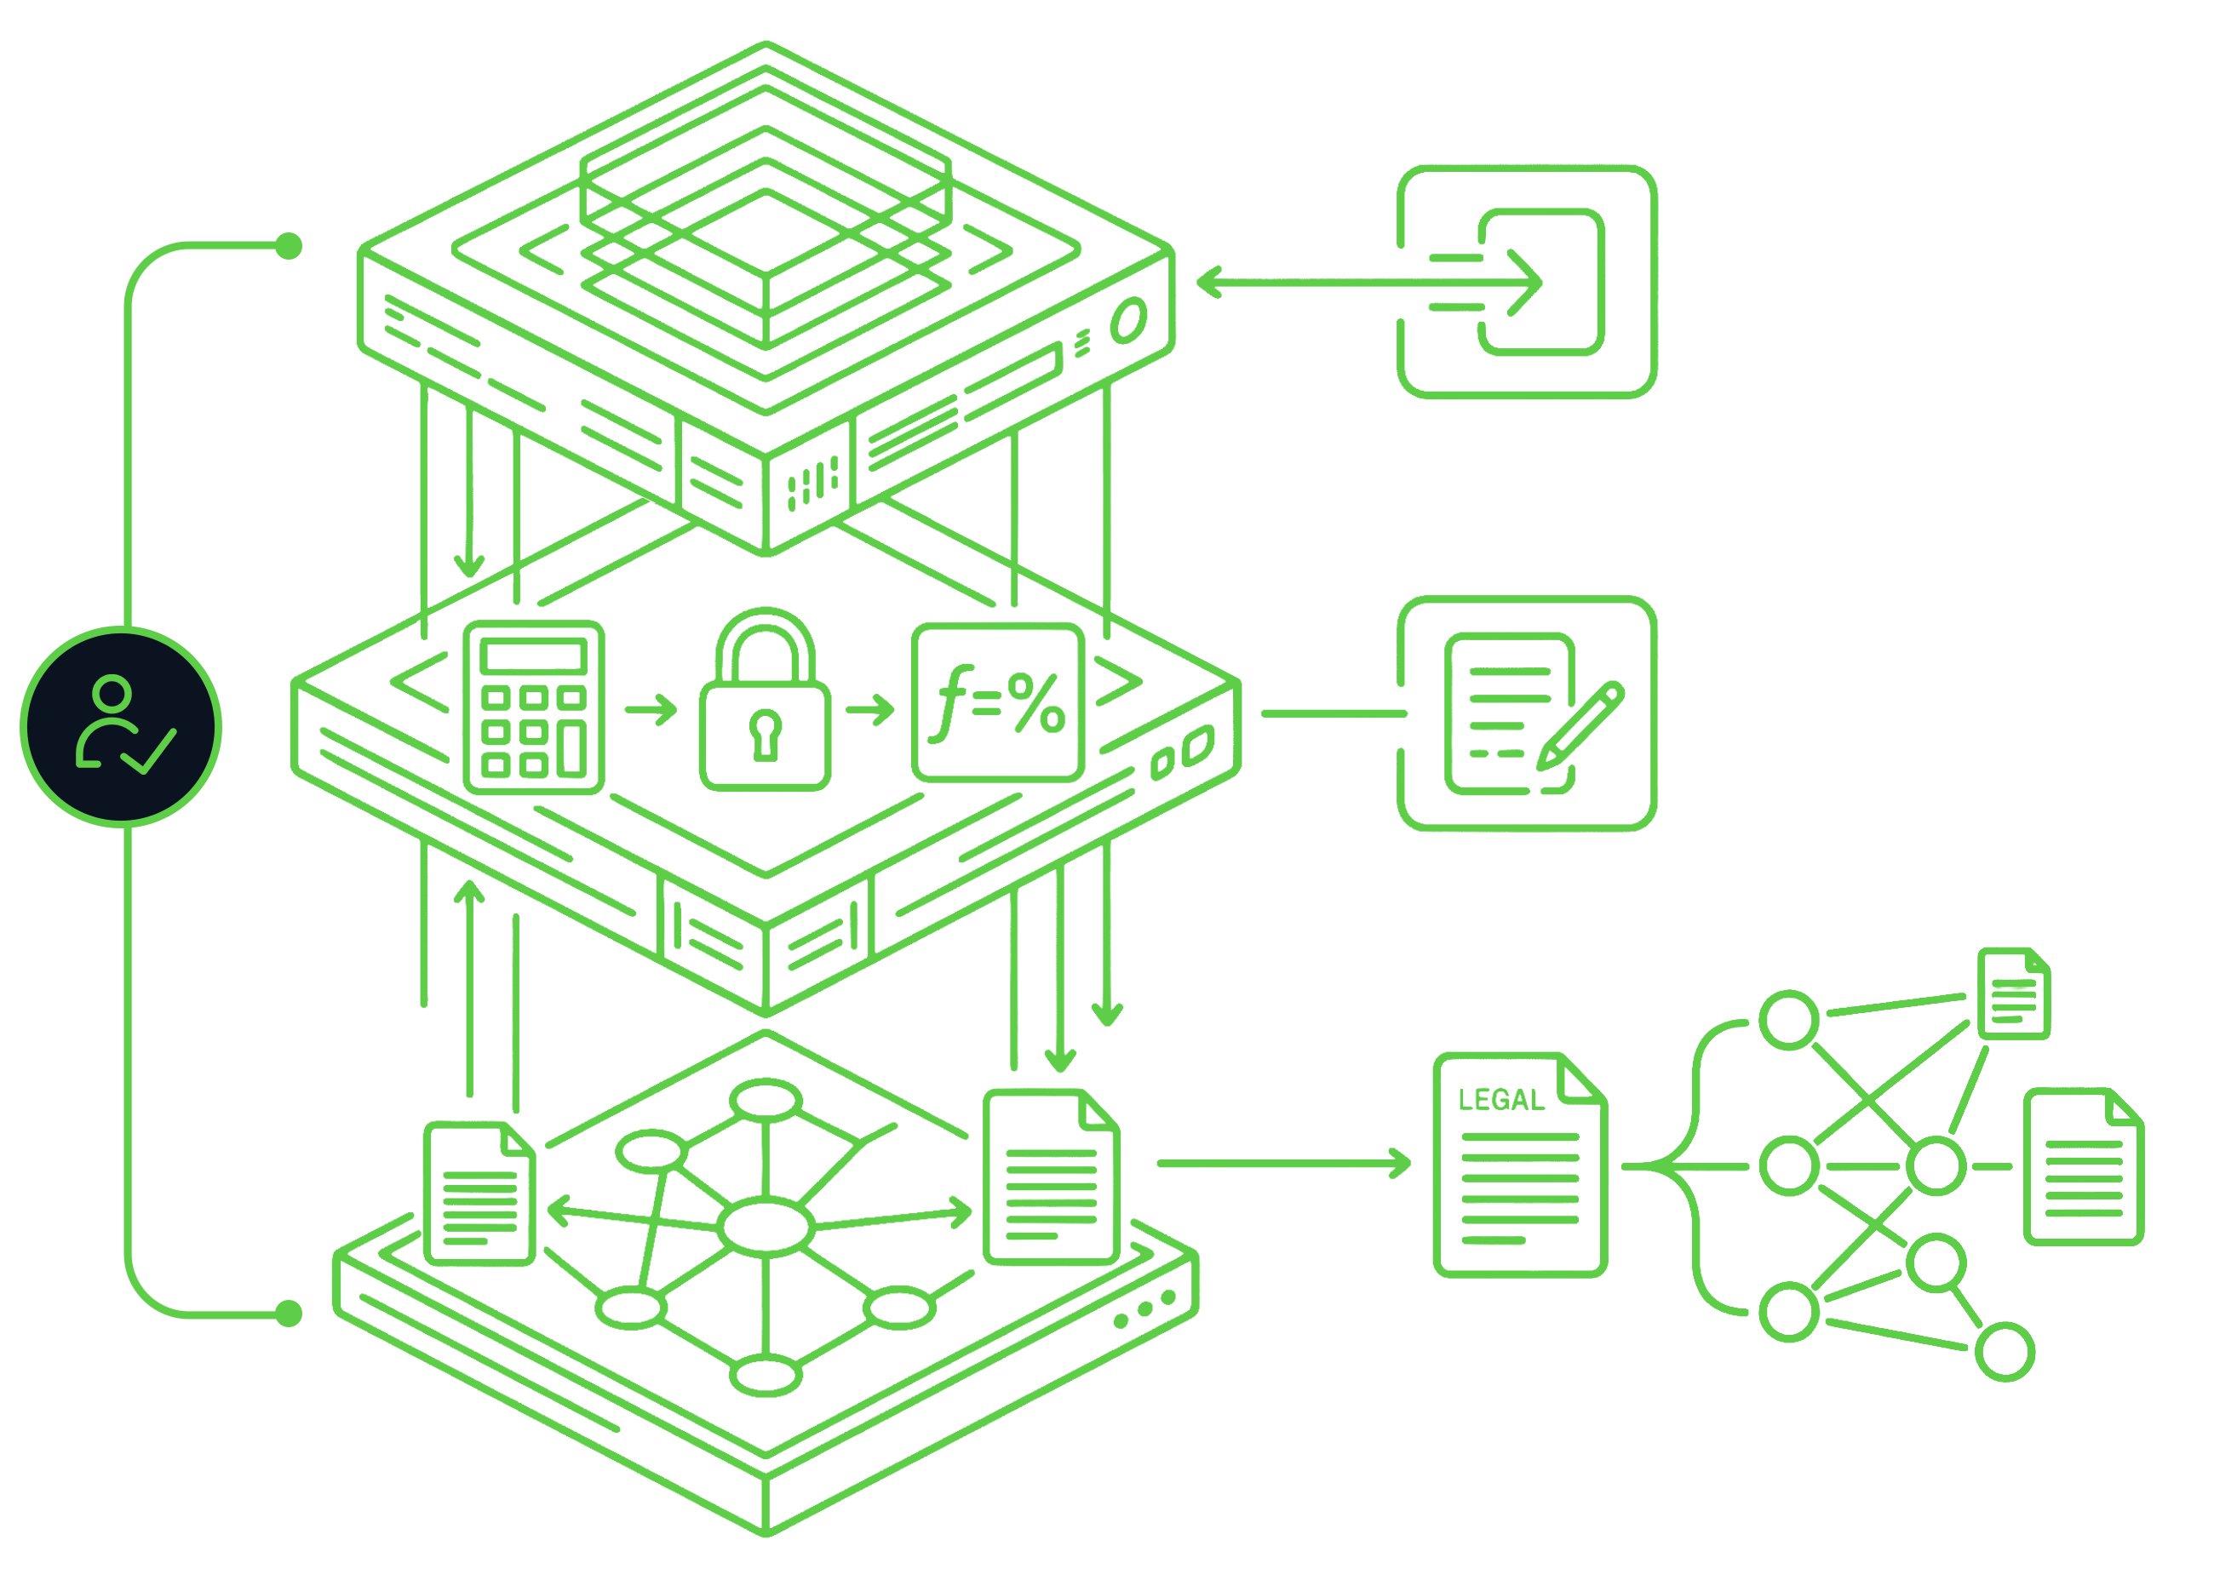
BUILT FOR THE WORK
Move faster without giving up control
Nodus applies the right kind of intelligence to the right part of the provision: AI to structure messy inputs, deterministic logic to run reproducible calculations, a graph to preserve relationships, and ASC 740 expertise to guide the judgment.
AI structures the inputs. Messy source materials become usable provision logic.
Deterministic logic runs the math. Excel executes the calculations, keeping the math transparent, reproducible, and review-ready.
The graph keeps the reasoning connected. Numbers, support, authority, assumptions, and judgment stay linked over time.
ASC 740 expertise guides the work. Human review stays in the process where professional judgment matters.
PROVISION CHAIN AUDIT

